Slide 1
Project Title: Bank Account System
Course: Data Structures with C++
Submitted By:
P. Bhagya Sri - 25A31A0589 (Team Lead)
P. Poojitha - 25A31A0590
P. Syam Sundar - 25A31A05AX
R.Hemanth Sai - 25A31A05AY
Under the Guidance of: Mrs. T.N.V. Durga
CSE Department

Slide 2
Project Description
Concept: A menu-driven console application simulating real-world banking operations
Core Objective: To manage customer accounts, transactions, and records efficiently using optimized Data Structures
Key Operations:
- Account Creation & Deletion
- Fund Deposits & Withdrawals
- Transaction History Tracking
- High-speed Account Searching

Slide 3
System Architecture
User Input
↓
Main()
↓
Banking System
↓
Account (Base Class)
↓
Savings / Current (Derived)
↓
Operations (Create, Deposit, Withdraw, Display)
↓
Output

Slide 4
Core Algorithms (The Logic)
Algorithm 1: Creation
Uses Linked List Append to add new nodes at the tail
Algorithm 2 & 6: Transactions
Balance updates are followed by a Stack Push to record history
Algorithm 3: Validation
Uses Virtual Functions for account-specific withdrawal rules
Algorithm 4: Search
Performs Bubble Sort on an array followed by Binary Search (O(log n))
Algorithm 5: Deletion
Uses Node Removal logic by updating pointers (prev->next = curr->next) and deallocating memory

Slide 5
Data Structure Implementation
Node Structure:
Data Part: Account ID, Name, Balance
Pointer Part: *next to link to the next customer
Memory Management: Explicit use of new for allocation and delete for node removal to prevent memory leaks
Polymorphic Traversal: A single loop can display all account types correctly using the base class pointer

Slide 6
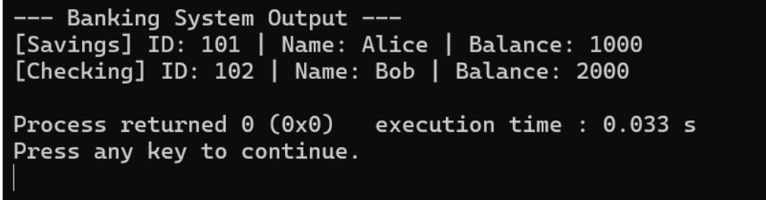
Execution & Output Proof
Analysis:
Shows successful creation of "Alice" (Savings) and "Bob" (Checking)
Demonstrates correct traversal of the Linked List
Confirms that the system correctly identifies account types during display

Slide 7
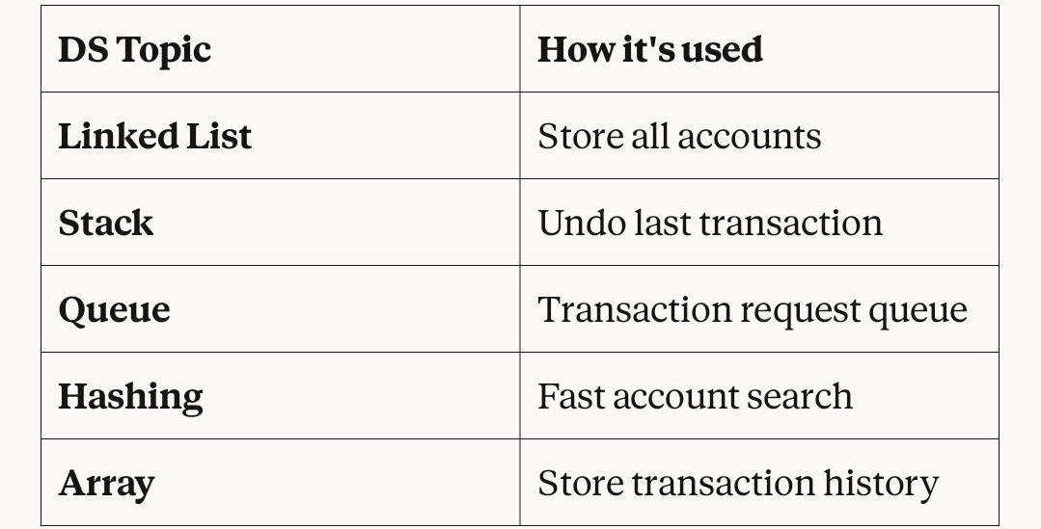
conclusion
Conclusion:
The project successfully demonstrates the use of linear data structures to solve real-world problem

